Slide 1
Agenda – Class 7 (1:00 to 3:00)
Starter Quiz
2 Students – Banking Experience Talk
Core Banking Platform Engineering : Country Dimensions (Contd..)
Regulations and Compliance
Open Banking API
Accounting Models
Steps to build a new Core Product Processor
Thought Paper Presentation Discussion - First One in Next Class in September 23rd
Note:
Mobile Phones – Do not bring to class or Completely Switch off
If students have any specific topic they want to discuss, share the topic and we can try to schedule

Slide 2
Starter Quiz
What is the WORLD’S largest Mobile Payment Platform ?
Alipay in China
What is the name of the mysterious and unknown person who designed and created the original implementation protocol for Bitcoin
Satoshi Nakamoto

Slide 3
Student – Banking Experience Talk
Two Student’s per class for each day (August 19th, 20th morning and 20th evening, 21st) will be randomly selected (so a total of 8 for the week) and will have to come on stage and give a 15 Min talk of their Banking Product they use and details around the same such as
Bank Name
Bank Product (‘s) Name and Type
What is the Format of your Bank Account Number (Size, Is there a Check Digit, Is it based on your Branch Code etc..)
What Apps (Bank Channels, Payment Apps) do you use to operate and initiate Transactions on the Account
What type of Transactions do you do on your account
What is the Average Number of Transactions done Daily, Weekly last couple of months
What is the highest / lowest amount Transaction done in last couple of months
What Interest and Fees are charged on your account and What is the Frequency of these Charges
What is the Interest Rate and When was the Last Interest Payment done by the Bank
What kind of notifications/communications specific to your account you receive from your Bank
What Improvements you would like to see in your Interaction experience with your Bank
Any thing else U would like to share on your Bank / your Banking Product

Slide 4
Core Banking Platforms Engineering – Capability Layering
To Engineer Globally Adaptable / Extendible Core Banking Platforms, Capabilities have to be categorized in to 3 Levels:
Global – Capability that is Generic and used by Multiple Countries
Country Specific – Capability varies typically by each Country
Client Specific – Capability that can potentially vary by each Client
In this Chapter we will focus on what capabilities that typically vary by Country and some techniques of how to handle these.

Slide 5
Core Banking Platforms Engineering – Country Variation Considerations
Capabilities that Generally Vary by Country (Contd..):
Regulators and Compliance
Open Banking API
Accounting Models

Slide 6
Banking Regulations
Notes:
Banking regulations vary widely across countries and govern critical aspects such as customer verification, anti-money laundering, and data privacy. This section covers the types of regulations, their variations, and examples of regulatory bodies worldwide.

Slide 7
Types of Banking Regulations (KYC, AML, Data Privacy)
Know Your Customer (KYC)
KYC regulations require banks to verify customer identities to prevent fraud and ensure secure transactions.
Anti-Money Laundering (AML)
AML laws prevent illicit financial activities by monitoring and reporting suspicious transactions.
Data Privacy Regulations
Data privacy laws safeguard customer information to maintain confidentiality and trust in banking systems.
Notes:
--- Key regulations include Know Your Customer (KYC) for identity verification, Anti-Money Laundering (AML) to prevent illicit finance, and data privacy laws to secure customer information. Compliance with these regulations is mandatory for all banking platforms. Image source: Microsoft 365 content library

Slide 8

Variation in Regulatory Requirements Across Countries
Country-Specific Regulations
Each country has unique regulatory requirements shaped by local laws and risk considerations.
Importance of Compliance
Global banks must understand and comply with varying regulations to avoid legal penalties.
Notes:
--- Different countries impose unique regulatory demands according to local laws and risk profiles. Understanding these variations is essential for banks operating globally to ensure compliance and avoid legal penalties. Image source: Microsoft 365 content library

Slide 9

Regulatory Bodies
Key Regulatory Authorities
Each Country has Banking Regulators to Over See Banks and Financial Institutions with in the Country
Regulator defines the Regulatory Norms and Enforces them with constant monitoring and audits
Regulatory Norms are updated at regular frequencies evolving with new technologies, product types and consumer/market evolutions
Example of regulatory bodies RBI in India and Federal Reserve in US
Notes:
--- Important regulatory authorities include the Financial Conduct Authority (FCA) in the UK, the Federal Reserve and FDIC in the USA, and the European Banking Authority (EBA). Frameworks such as Basel III set international banking standards. Image source: Microsoft 365 content library

Slide 10
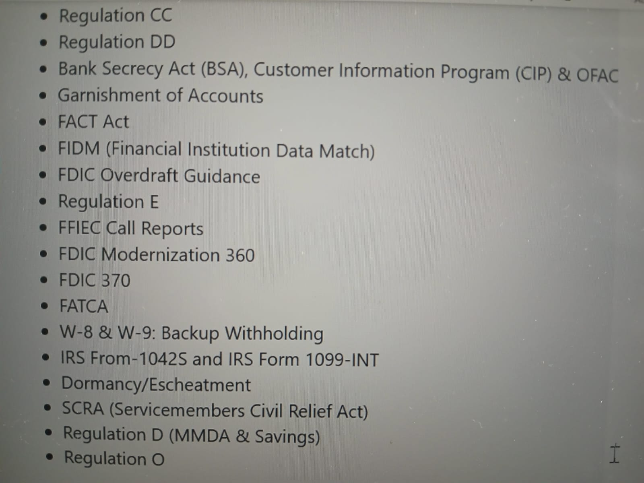
Sample US Deposits Regulations – Large in Number and Complex
Notes:
--- Important regulatory authorities include the Financial Conduct Authority (FCA) in the UK, the Federal Reserve and FDIC in the USA, and the European Banking Authority (EBA). Frameworks such as Basel III set international banking standards. Image source: Microsoft 365 content library

Slide 11
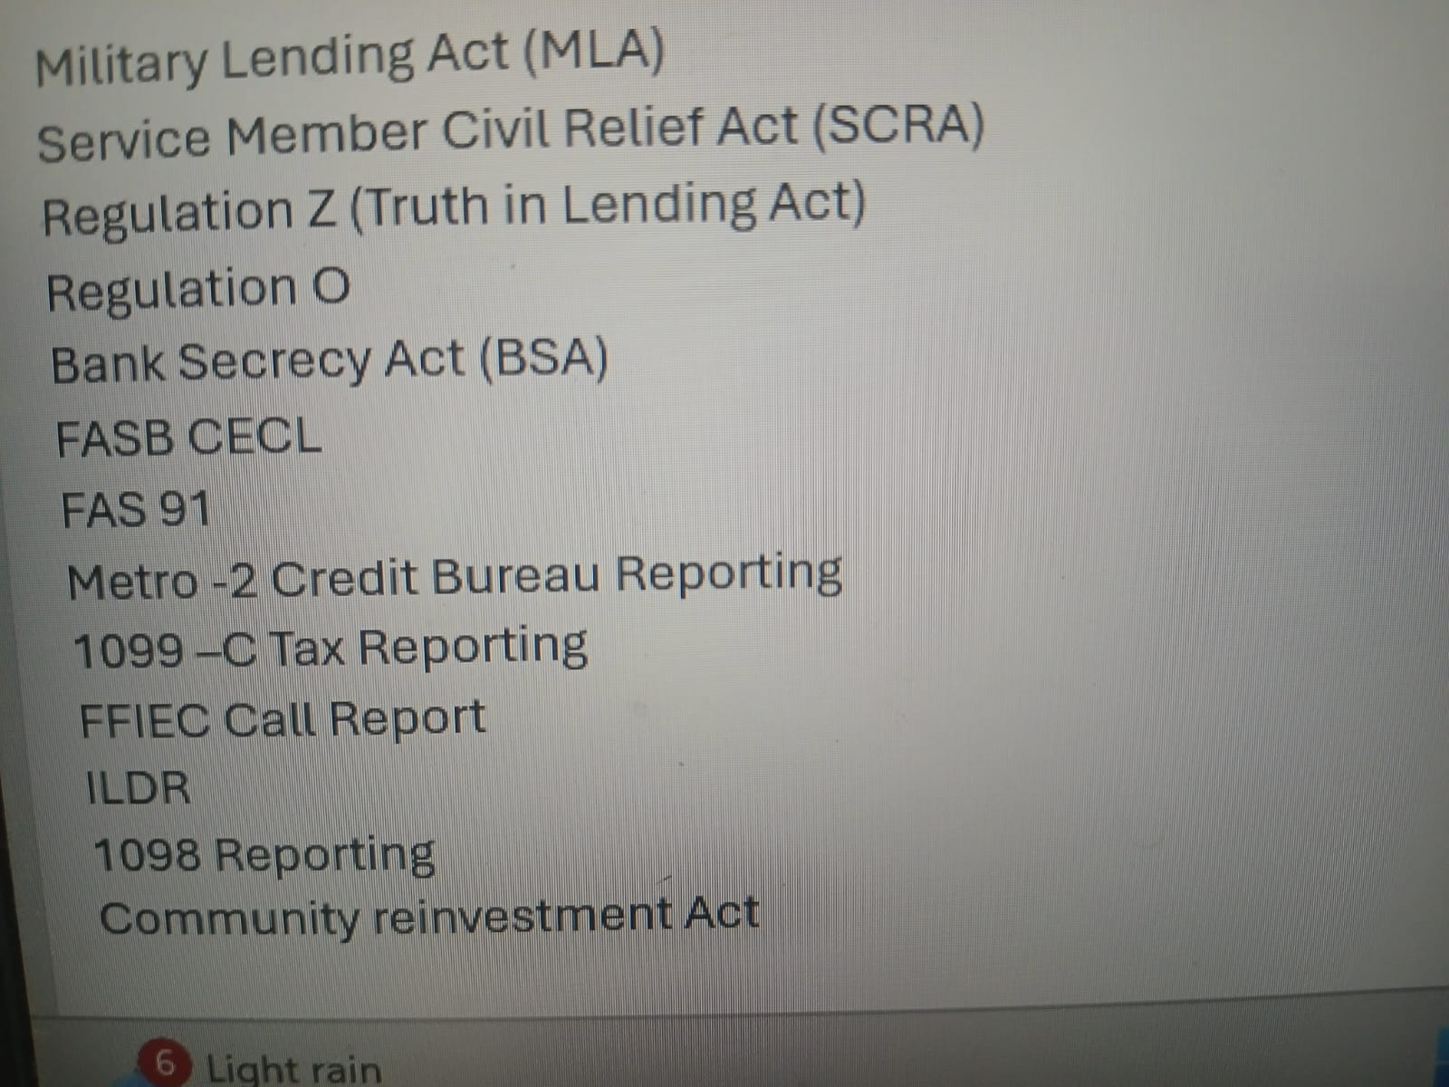
Sample US Lending Regulations – Large in Number and Complex
Notes:
--- Important regulatory authorities include the Financial Conduct Authority (FCA) in the UK, the Federal Reserve and FDIC in the USA, and the European Banking Authority (EBA). Frameworks such as Basel III set international banking standards. Image source: Microsoft 365 content library

Slide 12
Engineering Core Banking Platforms for Compliance
Notes:
Building compliance into the platform’s architecture ensures adaptability and adherence to evolving regulations. This section discusses incorporating compliance by design, managing regulatory updates, and automating compliance monitoring.

Slide 13
Building Compliance into Core Banking Platform Architecture
Embedding Regulatory Requirements
Incorporate compliance rules directly within Core Banking Platform and processing to ensure continuous adherence to regulations.
Integrating with Regulatory Reporting Component
Integrating with a Regulatory Reporting Component to generates the various Reports and Extracts as defined by the Regulator (Format, Content, Timing)
Regulatory Certification process
Regulatory Certification process need to be thorough including with an Independent Compliance Expert Signing off Certification Process and Results and using External Specialist Vendor as needed
The Certification Process needs to include a full automation testing capability so that these tests can be done repeatedly in a cost effective manner
Notes:
--- Compliance by design involves embedding regulatory requirements into system workflows, access controls, and data handling processes. This proactive approach reduces risks and facilitates audit readiness. Image source: Microsoft 365 content library

Slide 14

Adapting to Regulatory Changes and Updates
Flexibility in Banking and Regulatory Reporting Platforms
Banking platforms need flexibility to adapt quickly to frequent regulatory changes and updates.
Compliance Office
Dedicated Office with special expertise in regulatory domain and who is the point of contact with the regulators and will independently certify if a Core Banking Platform is meeting the Regulations
Change Management Processes and Strong Certification
Effective change management processes ensure smooth and swift regulatory compliance updates.
Usage of AI to analyze Regulatory changes and its impact
AI is now being used to analyze Regulatory changes and assess its impact (Processing, Reporting ..)
Notes:
--- Banking platforms must be flexible to accommodate frequent regulatory updates. Modular system design and effective change management processes help swiftly implement necessary modifications. Image source: Microsoft 365 content library

Slide 15
What is Open Banking?
Secure Data Sharing
Open banking enables customers to safely share their financial data with authorized third-party providers.
Access to Innovative Services
Customers gain access to new and innovative financial services through open banking frameworks.
Fostering Competition
Open banking promotes competition among financial service providers, benefiting customers with better options.
Notes:
--- Open banking is a framework that allows customers to share their financial data securely with authorized third parties to access innovative financial services, fostering competition and innovation. Image source: Microsoft 365 content library

Slide 16

APIs Enable Secure Communication
APIs facilitate safe and seamless interaction between banks and third-party providers in open banking systems.
Payment Initiation APIs
These APIs allow third parties to initiate payments directly from users' bank accounts securely and efficiently.
Account Information APIs
Account information APIs provide authorized providers access to users' banking data for services like budgeting and analytics.
Identity Verification APIs
Identity verification APIs ensure user authentication, enhancing security during banking transactions.
Role and Types of APIs in Open Banking
Notes:
--- APIs (Application Programming Interfaces) enable secure communication between banks and external providers. Key types include payment initiation APIs, account information APIs, and identity verification APIs. Image source: Microsoft 365 content library

Slide 17

Open Banking Examples: United Kingdom (PSD2), Australia (CDR), India (Account Aggregator)
UK PSD2 API Standards
The UK's PSD2 enforces API standards to enhance banking transparency and interoperability.
Australia Consumer Data Right
Australia’s CDR empowers consumers to control and share their personal data securely.
India Account Aggregator System
India’s Account Aggregator framework enables safe, streamlined data sharing across financial sectors.
Notes:
--- The UK’s PSD2 mandates API standards for banks. Australia’s Consumer Data Right (CDR) promotes consumer data control, while India’s Account Aggregator system enables secure data sharing across financial sectors. Image source: Microsoft 365 content library

Slide 18

Data Security
Compliance frameworks require strong data security measures to protect sensitive information from breaches and unauthorized access.
Customer Consent
Obtaining and managing explicit customer consent is essential for regulatory compliance and building customer trust.
API Standardization
Standardizing APIs ensures interoperability, consistency, and compliance across different systems and platforms.
Reporting Requirements
Accurate and timely reporting is necessary to maintain regulatory approval and demonstrate adherence to compliance standards.
Compliance Requirements and Standards
Notes:
--- Each framework has specific compliance requirements including data security, customer consent, API standardization, and reporting. Adhering to these ensures trust and regulatory approval. Image source: Microsoft 365 content library

Slide 19
Introduction Accounting Models
Notes:
Core banking systems are critical for managing banking operations efficiently. This section explains their functions and highlights the importance of consistent accounting standards such as US GAAP, IFRS, and India GAAP in ensuring reliable financial reporting.

Slide 20

Importance of accounting standards in banking
Uniform Financial Reporting
Accounting standards provide uniform guidelines ensuring consistent financial reporting across banks.
Transparency in Banking
Standards promote transparency, allowing stakeholders to clearly understand banks’ financial health.
Regulatory Compliance
Adherence to accounting standards ensures banks meet regulatory requirements and maintain trust.
Notes:
--- Accounting standards ensure uniformity, transparency, and comparability in financial reporting. For banks, adherence to these standards is crucial to accurately reflect financial health and comply with regulatory requirements. Image source: Microsoft 365 content library

Slide 21

Introduction to US GAAP, IFRS, and India GAAP
Overview of US GAAP
US GAAP is a rules-based accounting framework widely used in the United States with specific recognition and measurement guidelines.
IFRS Framework
IFRS offers a principles-based approach used internationally, focusing on transparency and comparability in financial reporting.
India GAAP Characteristics
India GAAP follows local regulations with distinctions in recognition and disclosure requirements tailored for the Indian banking sector.
Notes:
--- US GAAP, IFRS, and India GAAP are the predominant accounting frameworks used globally. Each has distinct principles affecting recognition, measurement, and disclosure requirements in banking financial statements. Image source: Microsoft 365 content library

Slide 22
Key Features of US GAAP in Core Banking
Notes:
US GAAP provides detailed guidance for banking accounting, focusing on rules-based recognition and measurement of financial instruments, revenue recognition, loan accounting, and robust disclosure requirements.

Slide 23

Recognition and measurement of financial instruments
Classification under US GAAP
Financial instruments are classified according to US GAAP rules to determine appropriate measurement and reporting.
Measurement Criteria
Measurement involves fair value and amortized cost based on the instrument type and accounting guidance.
Impairment Rules
Strict impairment criteria under US GAAP determine reductions in asset values impacting financial statements.
Impact on Bank Assets
Classification and measurement rules significantly influence bank asset valuations and financial reporting accuracy.
Notes:
--- Under US GAAP, financial instruments are classified and measured based on specific guidance, with strict criteria for impairment and fair value measurement that affect bank asset valuations. Image source: Microsoft 365 content library

Slide 24

Revenue recognition and loan accounting
Interest Income Recognition
US GAAP provides clear guidelines for recognizing interest income to reflect true earnings from loans.
Fee Recognition
Accurate recognition of fees ensures transparent reporting of additional revenue streams in banking.
Loan Loss Provisions
Provisions for loan losses are recorded to reflect credit risk and potential financial impacts accurately.
Notes:
--- US GAAP outlines explicit methods for recognizing interest income, fees, and loan loss provisions, ensuring banks accurately reflect their earnings and credit risk exposure. Image source: Microsoft 365 content library

Slide 25

Disclosure requirements specific to banks
Credit Risk Disclosure
Banks must provide detailed disclosures on credit risk to inform stakeholders of potential financial exposures.
Loan Portfolio Information
Disclosure of loan portfolios includes breakdowns of loan types and quality to improve transparency.
Capital Adequacy Reporting
Banks must disclose capital adequacy measures to demonstrate financial stability and regulatory compliance.
Notes:
--- Banks under US GAAP must comply with comprehensive disclosure mandates including detailed information on credit risk, loan portfolios, and capital adequacy to enhance transparency. Image source: Microsoft 365 content library

Slide 26
IFRS Standards and Their Impact on Core Banking
Notes:
IFRS adopts a principles-based approach, emphasizing fair value measurement and transparency. IFRS 9 significantly reshaped financial instruments accounting affecting banks globally.

Slide 27
Principles-based approach under IFRS
Broad Principles over Rules
IFRS applies broad accounting principles, allowing adaptability rather than strict prescriptive rules.
Flexibility in Application
The principles-based approach offers flexibility but demands careful professional judgement in financial reporting.
Recognition and Measurement
Judgement is crucial in recognizing and measuring financial instruments under IFRS standards.
Notes:
--- IFRS focuses on applying broad principles rather than prescriptive rules, offering flexibility but also requiring significant judgement in recognizing and measuring financial instruments. Image source: Microsoft 365 content library

Slide 28

IFRS 9: Financial Instruments and its implications
Expected Credit Loss Model
IFRS 9 requires banks to estimate expected credit losses, improving the accuracy of impairment recognition.
Classification of Financial Assets
New criteria for classifying financial assets affect how banks report and manage their loan portfolios.
Impact on Financial Reporting
The standard significantly changes bank loan loss provisioning and overall financial disclosures.
Notes:
--- IFRS 9 introduced expected credit loss models for impairment and new classification criteria for financial assets, substantially impacting bank loan loss provisioning and financial reporting. Image source: Microsoft 365 content library

Slide 29

Comparative disclosures and transparency
Enhanced Financial Risk Disclosures
IFRS mandates detailed disclosures on financial risks to improve transparency and comparability across banks.
Credit Quality Reporting
Detailed credit quality disclosures help investors assess the bank's loan portfolio health and risk levels.
Management Strategies Transparency
Disclosing management strategies enhances investor confidence in how banks handle risks and opportunities.
Notes:
--- IFRS requires enhanced disclosures on financial risks, credit quality, and management strategies, improving comparability and investor confidence in banking financial statements. Image source: Microsoft 365 content library

Slide 30
India GAAP: Unique Features and Regulatory Framework
Notes:
India GAAP incorporates specific provisions relevant to Indian banks, with a recent transition to Ind AS aligning more closely with IFRS while retaining unique regulatory elements.

Slide 31

Key provisions relevant to banking operations
Income Recognition Guidance
India GAAP provides specific rules for recognizing income in banking to ensure accurate financial reporting.
Provisioning Norms
Provisioning norms under India GAAP determine how banks set aside funds for potential loan losses.
Asset Classification
India GAAP outlines asset classification standards to categories banking assets for risk and regulatory purposes.
Notes:
--- India GAAP includes particular guidance on income recognition, provisioning norms, and asset classification tailored to India’s banking environment. Image source: Microsoft 365 content library

Slide 32

Transition to Ind AS and its impact on banks
Alignment with IFRS
Ind AS adoption aligns Indian accounting standards closely with international IFRS guidelines, promoting consistency.
New Measurement Bases
Introduction of new measurement bases under Ind AS affects how banks value assets and liabilities in their financial statements.
Disclosure Requirements
Enhanced disclosure requirements improve transparency in bank financial statements under Ind AS framework.
Capital Adequacy Effects
Changes in accounting standards impact banks' capital adequacy calculations and regulatory compliance.
Notes:
--- The move to Ind AS has aligned Indian accounting standards more closely with IFRS, introducing new measurement bases and disclosure requirements that affect bank financial statements and capital adequacy. Image source: Microsoft 365 content library

Slide 33

Regulatory oversight and compliance requirements
Regulatory Authority
The Reserve Bank of India enforces strict regulatory compliance on Indian banks to ensure financial stability and transparency.
Accounting Policies
Indian banks must adhere to regulations impacting accounting policies to align with India GAAP and Ind AS standards.
Provisioning and Disclosures
Compliance requirements include strict rules on provisioning for bad debts and transparent financial disclosures.
Notes:
--- Indian banks face stringent regulatory compliance enforced by the Reserve Bank of India, affecting accounting policies, provisioning, and disclosures under India GAAP and Ind AS. Image source: Microsoft 365 content library

Slide 34
Comparative Analysis and Practical Considerations
Notes:
This section summarizes the key similarities and differences across US GAAP, IFRS, and India GAAP and discusses implementation challenges and best practices for banks operating across multiple jurisdictions.

Slide 35

Key similarities and differences among the models
Common Goal
All frameworks aim to ensure transparent and reliable financial reporting across organizations.
US GAAP Characteristics
US GAAP is primarily a rules-based framework with detailed standards and specific guidelines.
IFRS Characteristics
IFRS is a principles-based system focusing on broad guidelines and professional judgement.
India GAAP Features
India GAAP combines local regulations with IFRS convergence, especially through Ind AS standards.
Notes:
--- While all frameworks aim for transparent and reliable financial reporting, US GAAP is more rules-based, IFRS more principles-based, and India GAAP blends local regulations with IFRS convergence, especially through Ind AS. Image source: Microsoft 365 content library

Slide 36

Challenges in implementation across jurisdictions
Impairment Model Differences
Banks must reconcile diverse impairment models used across jurisdictions, complicating financial reporting consistency.
Disclosure Requirements Variation
Varying disclosure standards across countries create challenges for multinational banks in transparent reporting.
Regulatory Compliance Navigation
Banks must navigate complex and diverse regulatory environments to ensure compliance globally.
Notes:
--- Multinational banks face challenges such as reconciling differences in impairment models, varying disclosure requirements, and navigating regulatory compliance in different countries. Image source: Microsoft 365 content library

Slide 37

Building a New Core Product Processor

Slide 38
Steps in Building a New Core Product Processor
Solution Definition
Test Strategy Definition
Business Process Flow Design and Definition of each Business Process
Interface Level Detailing, Implementation, Certification Incl Regression Test Automation
Component Level Certification Incl Regression Test Automation
Solution Certification Level of each Business Process and overall End to End Solution Incl Regression Test Automation

Slide 39
Steps in Building a New Core Product Processor – First Time Activities
Standards and Frameworks
Standards Definition (e.g.: Artifact Naming, UI/UX Styling, Headers ..)
Base Frameworks (e.g. Caching, Logging, ..)
Consumption of Cloud Native Services
CI-CD Pipe line standards using Jenkins
Code Scanning - Identify Open source or Azure Cloud Provisioned and include in the Pipe Line
Rule sets e.g. Sonar
Opensource Scans
Security Scans
Container Scans
Test Automation Framework and Inclusion of Automation Testing in Pipeline
Check Lists
Code Review Checklist
Unit Test Checklist
Function Test / Component Test / Solution Test Checklist

Slide 40
Steps in Building a New Core Product Processor – First Time Activities
Development and Test Repositories, Environments Provisioning, Deployment and Monitoring
Developer Level
Group Level
Component Level
Solution Level
Planning and Tracking
Deliverables
Activities/Tasks
Dependencies
Estimates
Allocation
Key Milestones
Sprint Cycles – 2 Weeks
Planning, Retrospectives, Continuous Improvements
Daily Status Standups – Group Level, Team Level
Design Sessions / Brainstorming Sessions
Reporting (Group Level, Team Level) – Daily, Weekly, Sprint Cycles

Slide 41
Solution Definition - Basics
Overall Solution Design which covers
List of Components Participating in the Solution
List of Apps with in each Component Participating in the Solution
Integration Pattern between each Participating Component
List of Business Processes applicable for the Core Product Processor
List of Country Regulations to be fulfilled Incl Data Protection / Privacy Rules
Broad Functional Requirements
Broad Non Functional Requirements
Scalability
Performance SLA’s
Security
Observability
Operational
Others
Broad Consumer Characteristics

Slide 42
Test Strategy Definition
Overall Test Strategy Definition
Types/Phases of Tests Done
Unit Testing
Code Scanning
Interface Level Testing
Component Level Testing
Solution Level Testing
Entry and Exit Criteria (Definition of Done) for Each Test Type/Phases
Testing Tools
Test Case Definition Tools
Test Automation Frameworks
Defect Management Tools
..

Slide 43
Introduction to Business Process Modelling
Notes:
This section introduces the fundamental concepts behind Business Process Modelling, explaining why it is vital for organizations to understand and document their processes systematically.

Slide 44

Definition and purpose of business process modelling
Visual Representation of Workflows
Business process modelling creates clear visual diagrams of organizational workflows and activities for better understanding.
Improved Communication
Modelling business processes facilitates clearer communication among teams by making workflows easy to understand.
Facilitates Analysis and Optimization
Process modelling supports thorough analysis and optimization to enhance efficiency and effectiveness in operations.
Notes:
--- Business Process Modelling involves creating visual representations of an organization's workflows and activities. Its purpose is to clarify processes, improve communication, and facilitate analysis and optimization. Image source: Microsoft 365 content library

Slide 45

Key terms and concepts
Processes and Activities
Processes are sequences of activities that achieve specific goals within a system or organization.
Events and Actors
Events trigger processes, while actors are individuals or entities performing specific actions within workflows.
Workflows
Workflows represent the ordered execution of processes and activities to achieve objectives efficiently.
Notes:
--- Key concepts include processes, activities, events, actors, and workflows. Understanding these terms is essential for constructing accurate and meaningful process models. Image source: Microsoft 365 content library

Slide 46

Importance in modern organizations
Organizational Agility
Business Process Modelling enhances organizational agility by enabling quick adaptation to market changes and challenges.
Efficiency Improvement
Clear process mapping increases operational efficiency and reduces redundancies within organizations.
Transparency and Compliance
Transparent process models support compliance with regulatory requirements and improve organizational oversight.
Notes:
--- Business Process Modelling supports organizational agility, efficiency, and transparency. It helps organizations respond to market changes and regulatory requirements effectively by providing a clear process overview. Image source: Microsoft 365 content library

Slide 47
Common Methodologies and Notations
Notes:
This section reviews popular standards and techniques used in Business Process Modelling to standardize process documentation and improve clarity.

Slide 48

Business Process Model and Notation (BPMN)
Standard Visual Notation
BPMN offers a standard graphical notation that simplifies the visualization of complex business processes.
Bridging Stakeholders
BPMN helps bridge communication between technical teams and business stakeholders through clear visual language.
Notes:
--- BPMN is a widely accepted graphical notation that provides a standard way to visually depict business processes, making them easy to understand for both technical and business stakeholders. Image source: Microsoft 365 content library

Slide 49

Unified Modelling Language (UML)
Versatile Modelling Language
UML provides a flexible framework for modelling diverse software and business processes effectively.
Activity Diagrams
Activity diagrams specifically model business workflows and processes within software development and analysis.
Flowcharts
Flowcharts visually represent processes using symbols and arrows to map sequences clearly and simply.
Notes:
--- UML is a versatile modelling language that supports various diagram types including activity diagrams, which are used to model business processes and workflows within software development and business analysis contexts. Image source: Microsoft 365 content library

Slide 50

Process identification and documentation
Identify Key Processes
Begin by pinpointing essential processes crucial to the organization's operations and goals.
Gather Relevant Information
Collect detailed and accurate data related to each identified process for comprehensive understanding.
Document Workflows Accurately
Create precise and clear documentation of workflows to serve as a reliable foundation for modelling.
Notes:
--- The first step involves identifying key processes, gathering relevant information, and documenting workflows accurately to form the basis of the model. Image source: Microsoft 365 content library

Slide 51

Analysis and optimization
Process Analysis
Processes are examined to uncover inefficiencies and bottlenecks that hinder performance.
Model Refinement
Models are refined to improve performance and ensure alignment with organizational goals.
Process Implementation
Optimized processes are systematically implemented to improve efficiency and performance
Notes:
--- Once documented, processes are analyzed to identify inefficiencies or bottlenecks. Models are then refined to optimize performance and align with organizational goals. Image source: Microsoft 365 content library

Slide 52
Business Process Deliverables
Notes:
This section outlines the structured approach organizations follow to model, analyze, and improve their business processes effectively.

Slide 53
Business Process Flow Definition – Basic Deliverables
Business Process Flow Document
Reference Document Walk through
Interfaces Needed to Fulfill the Business Process, Including Interface Design/ Definition (e.g. API Swagger Contracts, UI Mocks ..)
API Interfaces
Event Interface
File Interfaces
Visual Interfaces (UI) – Including UX View
Self Service
Bank Employee
Agent / Partner
Operational Reports Interfaces
Compliance Reports Interfaces
Interfaces of the Integrating components
API’s , Events, File Interfaces

Slide 54
Business Process Flow Definition – Basic Deliverables
Business Process Flow Document
Reference Document Walk through
List all Components and Apps with in a Component that participate in the Business Process Flow
For each Component Involved: Interfaces Needed to Fulfill the Business Process, Including Interface Business Definition (e.g. API Input/Output Business Definition, UI/Report Mocks ..)
API Interfaces
Event Interface
File Interfaces
Visual Interfaces (UI) – Including UX View
Self Service
Bank Employee
Agent / Partner
Operational Reports Interfaces
Compliance Reports Interfaces
Interfaces of the Integrating components
API’s , Events, File Interfaces

Slide 55
Business Process Flow Definition – Basic Deliverable’s
Country Regulations to be covered as a part of that Business Process Flow
Non Functional Requirements e.g.
End to End Process Flow Time
…

Slide 56
Interface Detailing and Implementation
Notes:
This section outlines the structured approach organizations follow to model, analyze, and improve their business processes effectively.

Slide 57
Interface Detailing and Implementation
Detailing each Interfaces listed earlier and if any Batch Processes are needed
Interface Tech Definition (e.g. API Swagger Contracts ..)
Processing Rules Incl
Validations and Error / Information Messages
Country Regulations – Processing Requirements for the In Scope Countries
Database Persistence Actions
If API or Batch Process Events Emitted
If Event Listener Events Consumed
Integrating with Other Component Interfaces
Backward Compatibility Support
..
Test Scenarios and Test Cases to certify the Interface Implementation
Implement the Interface
Coding
Unit Testing
All Scans Completion
Code Review
Various Certifications (Functional, Performance, Security etc..)
Automated Regression Test Suite
Documentation and Other Artifact Deliverables

Slide 58
Certification
Notes:
This section outlines the structured approach organizations follow to model, analyze, and improve their business processes effectively.

Slide 59
Certification
Interface Level Certification
Meets DoD as defined in Test Strategy
Component / Core Product Processor Level Certification and Packaging and Release of all Apps in the Component
Certify all Apps in the Component are certified integrating them together
Validate all Scan Reports for each App meet the exit Criteria
Certification needs to Include Functional, Performance, Observability, Security, Interface Backward Compatibility, Regulatory/Compliance at Component Level, Integration Testing at a component level through Interface Mocks, Localization (Language, Date/Time/Amount Formats ..), Multi Cloud Testing, Documentation Testing ..
Meets DoD as defined in Test Strategy
Solution Level Certification and Packaging and Release at Solution Level – Final Gate Keeper who gives a Go – No Go for a Release
Integrate all Components, Deploy all Apps in each of the Component and do
End to End Business Process Flow Testing covering all components – Breadth Testing
End to End Compliance Testing
Solution Consistency Testing
Meets DoD as defined in Test Strategy

Slide 60
Analysis and Thought Paper Topics – Discussion

Slide 61
Analysis and Thought Paper Topics – Team Assignment
Topic Name | Team | Presentation Date
OCEN (Open Credit Enablement Network ) – India | 2 | Sept 23rd
ONDC (Open Network for Digital Commerce) - India | 6 | Sept 24th
Stablecoin | 4 | Sept 25th
AI in Financial Fraud Prevention and AML | 12 | Oct 7th
Embedded Finance – Concept, Evolution, Future Trends | 8 | Oct 8th
Global Payment Schemes Analysis and Comparison India – UPI US – ACH Europe – SEPA Brazil - Pix | 3 | Oct 9th

Slide 62
Analysis and Thought Paper Topics – Team Assignment
Topic Name | Team | Presentation Date
Consumer Persona’s – Banking Usage and Needs Analysis (Accounts, Types of Transactions, Volumes of Transactions, Types of Banking/Payment Apps used, How do they Interact/Interface with Bank, Regulations applicable for these Product Types, Are there gaps /improvements they would like to see from their Banking Product Features or would like Banking Products to be Offered and How they are Serviced/Supported by Bank), Banking Tech Requirements / expectations based for the analysis of these consumer Persona’s
Individuals – Student, Your Parents | 1- 5 2- 1 | 1- Oct 28th 2- Nov 11th
Micro/Small Business (2 Persona’s) – e.g. Street Vendor/Auto Driver, Kirana Shop/Small Farmer/Small Restaurant | 1- 9 2- 11 | 1- Oct 29th 2- Nov 10th
Start up / Entrepreneurs | 7 | Oct 30th
Large Institution (MIT Manipal ) | 10 | Nov 10th

